Slide 1
CAPSTONE PROJECT -III
Supervised ML
Classification
Cardiovascular_Risk_Prediction
Team Members:
Shubham Joshi
Kanika Kakra
Akshay Fasale
Rishikesh Damale

Slide 2
Acknowledgement
We would express our gratitude towards the entire team of “Almabetter” for acknowledging us with such important domain and providing us an opportunity to work on real life problems through Capstone Project.

Slide 3
Problem Statement
The classification goal is to predict whether the patient has a 10-year risk of future coronary heart disease (CHD). The dataset provides the patients’ information. Each attribute is a potential risk factor. There are both demographic, behavioral, and medical risk factors.

Slide 4
Algorithm
1.Importing the necessary packages and libraries.
2.Mounting the drive for importing the data.
3.Checking for missing,NaN values,Null values.
4.Observing the datatypes .
5.Observing the correlation among independent variables.
6. Exploring the data set.
7.Exploring the categorical values, numerical features from data set.
8.Exploring different target variable.
9.Splitting the data and training the data.
10.Observing the results.

Slide 5
Data Description
Predict variable (desired target)
• 10-year risk of coronary heart disease CHD(binary: “1”, means “Yes”, “0” means “No”) – DV
Demographic:
• Sex: male or female("M" or "F")
• Age: Age of the patient;(Continuous - Although the recorded ages have been truncated to whole numbers, the concept of age is continuous)
Behavioral:
• is_smoking: whether or not the patient is a current smoker ("YES" or "NO")
• Cigs Per Day: the number of cigarettes that the person smoked on average in one day.(can be considered continuous as one can have any number of cigarettes, even half a cigarette.)

Slide 6
Medical( history)
• BP Meds: whether or not the patient was on blood pressure medication (Nominal)
• Prevalent Stroke: whether or not the patient had previously had a stroke (Nominal)
• Prevalent Hyp: whether or not the patient was hypertensive (Nominal)
• Diabetes: whether or not the patient had diabetes (Nominal)
Medical(current)
• Tot Chol: total cholesterol level (Continuous)
• Sys BP: systolic blood pressure (Continuous)
• Dia BP: diastolic blood pressure (Continuous)
• BMI: Body Mass Index (Continuous)
• Heart Rate: heart rate (Continuous - In medical research, variables such as heart rate though in fact discrete, yet are considered continuous because of large number of possible values.)
• Glucose: glucose level (Continuous))

Slide 7
EDA and Feature Engineering
Exploratory data analysis or commonly known as EDA helps to explore data, and possibly formulate hypotheses that might cause new data collection and experiments. EDA build a robust understanding of the data, issues associated with either the info or process. It’s a scientific approach to get the story of the data.
Feature engineering mainly have two goals:
Preparing the proper input dataset, compatible with the machine learning algorithm requirements.
Improving the performance of machine learning models.

Slide 8
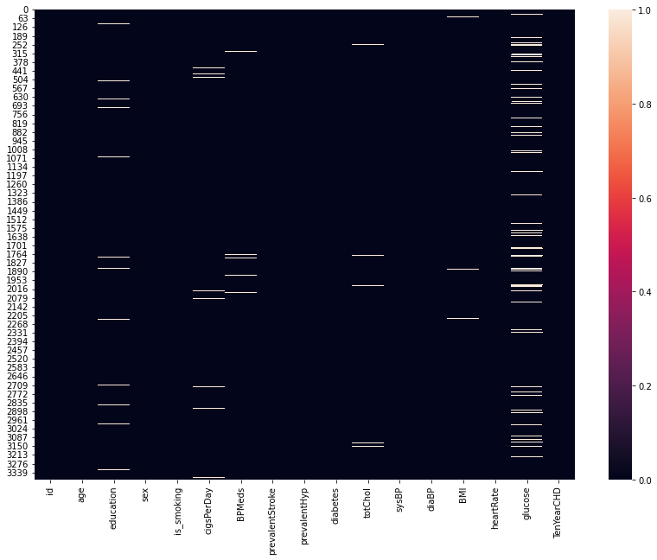
Heat Map for missing Values

Slide 9
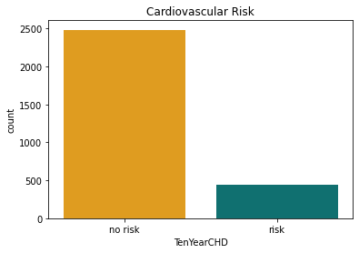
Data Visualization
1. It is clear the percentage/count of people with normal results are pretty high and this creates a problem of class imbalance. It could create problems for model to perform better in such case because the model will be baised towards the normal result predictions..

Slide 10
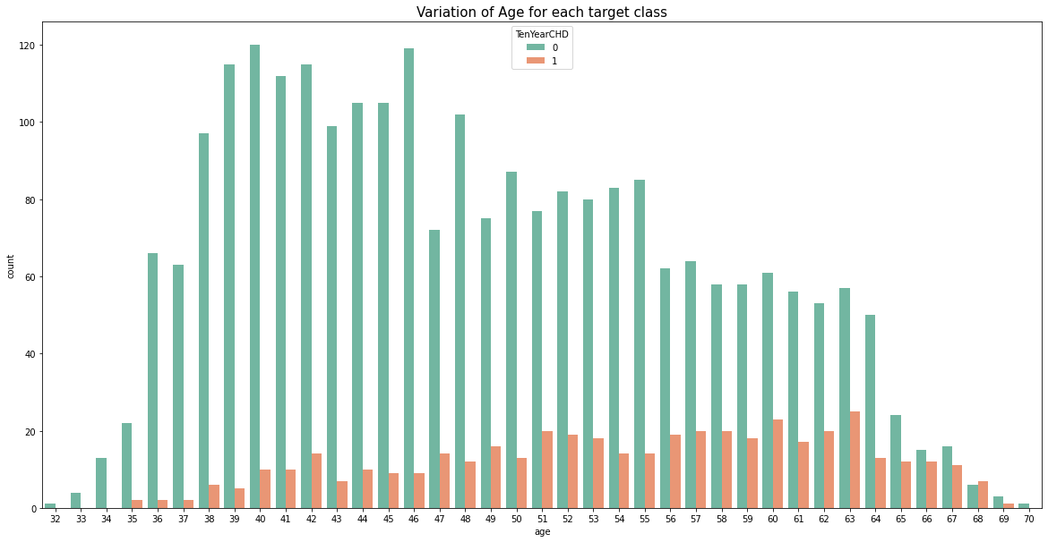
2.Here we see that CHD increases from 51 to 67 then decreases.

Slide 11
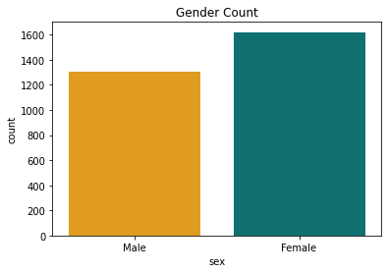
3.We observe that number of Female records are more than Male records in the dataset.

Slide 12
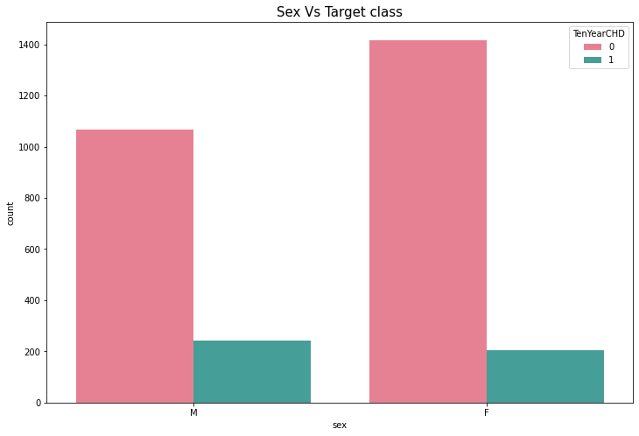
4.In the above bar chart we can say that no.of CHD female is less than male..

Slide 13
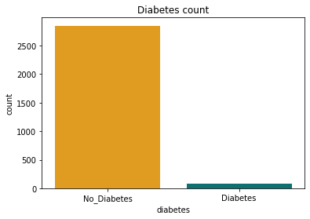
5.Only 79 people are diabetic in the data ..There is a large difference in the data ...(bias towards non diabetic ).

Slide 14
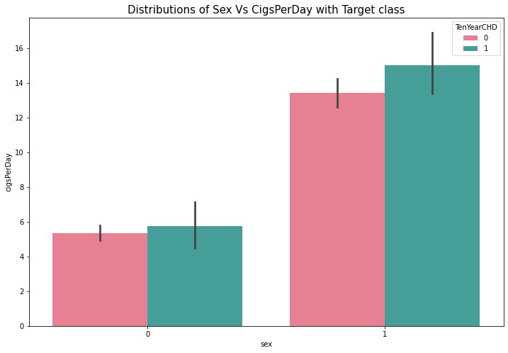
6.Its clear that number of males who smokes are significantly higher than the female smokers, even though the entries for female patients were more. This shows smoking is more common in males and its a major cause of CHDs for male patients.

Slide 15
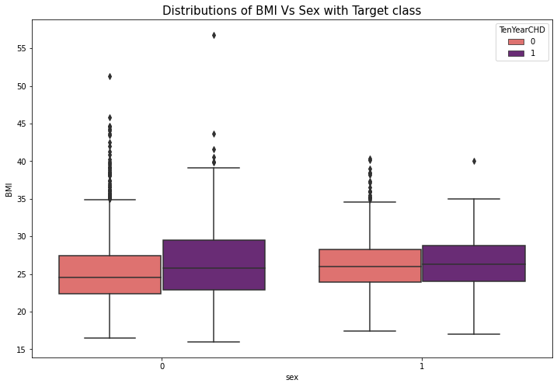
7.In above plot we can say that Female BMI is more than male BMI that's leads to overweight.
so,Female CHD is more than male CHD.

Slide 16
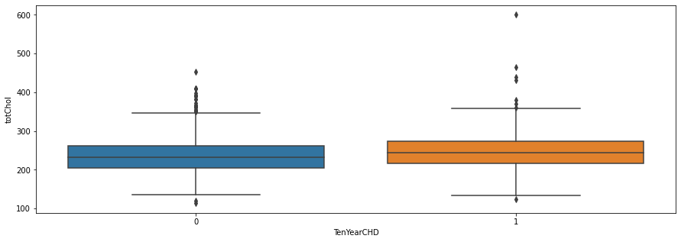
8.We observe that male Have little more cholestrol level than female.

Slide 17
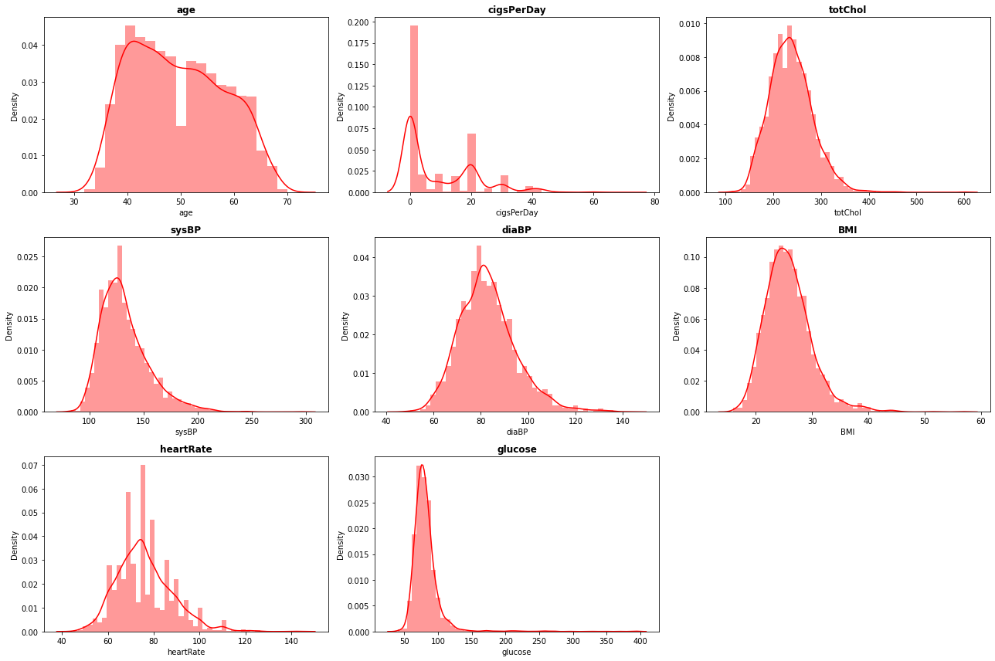
9.We can observe that most of the distributions are right skewed for numeric features. totChol (total cholesterol) and BMI have roughly similar distributions. Glucose have a highly right skewed distribution. It shows Glucose has a lot of outliers. Though it is usually a good practice to deal with such outliers, however in this case we can't do much about it as the data is taken through medical survey and the values are patient's health stats, hence those values are absolute and we should not manipulate them. We could have used techniques like Square root transformation, Log tranformation,etc., to convert them to near normal distribution, but since we can't manipulate a medical statistics of a person, it is suggestive to go with the actual values.

Slide 18
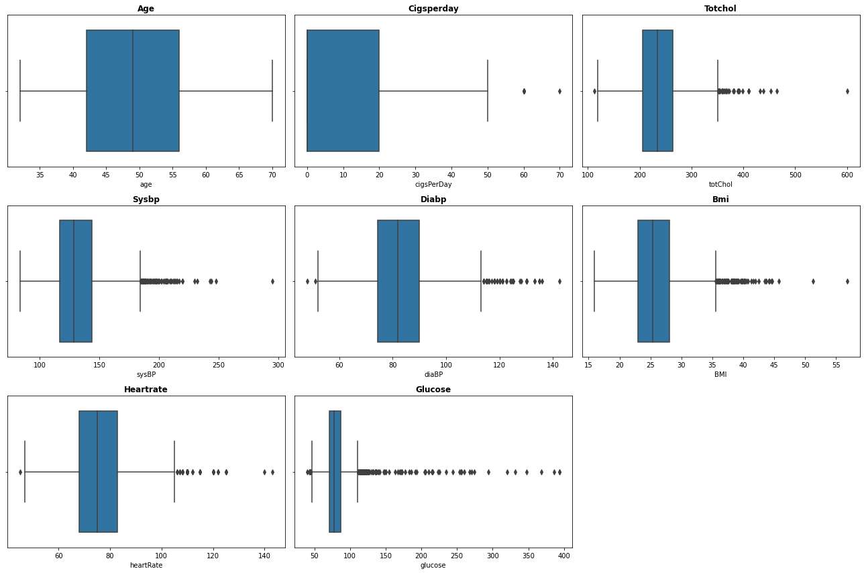
Box plot distributions for numeric features.
10.As we can see a lot of outliers in totchol, sysbp, diabp, BMI , Glucose. As we discussed we cant manipulate the data.If we drop the rows with this outliers we will lose a huge amount of important data so we cant drop them..We can only try to remove borderline outliers(with minimal data loss) which are unlikely to occure (doesnt make sense).

Slide 19
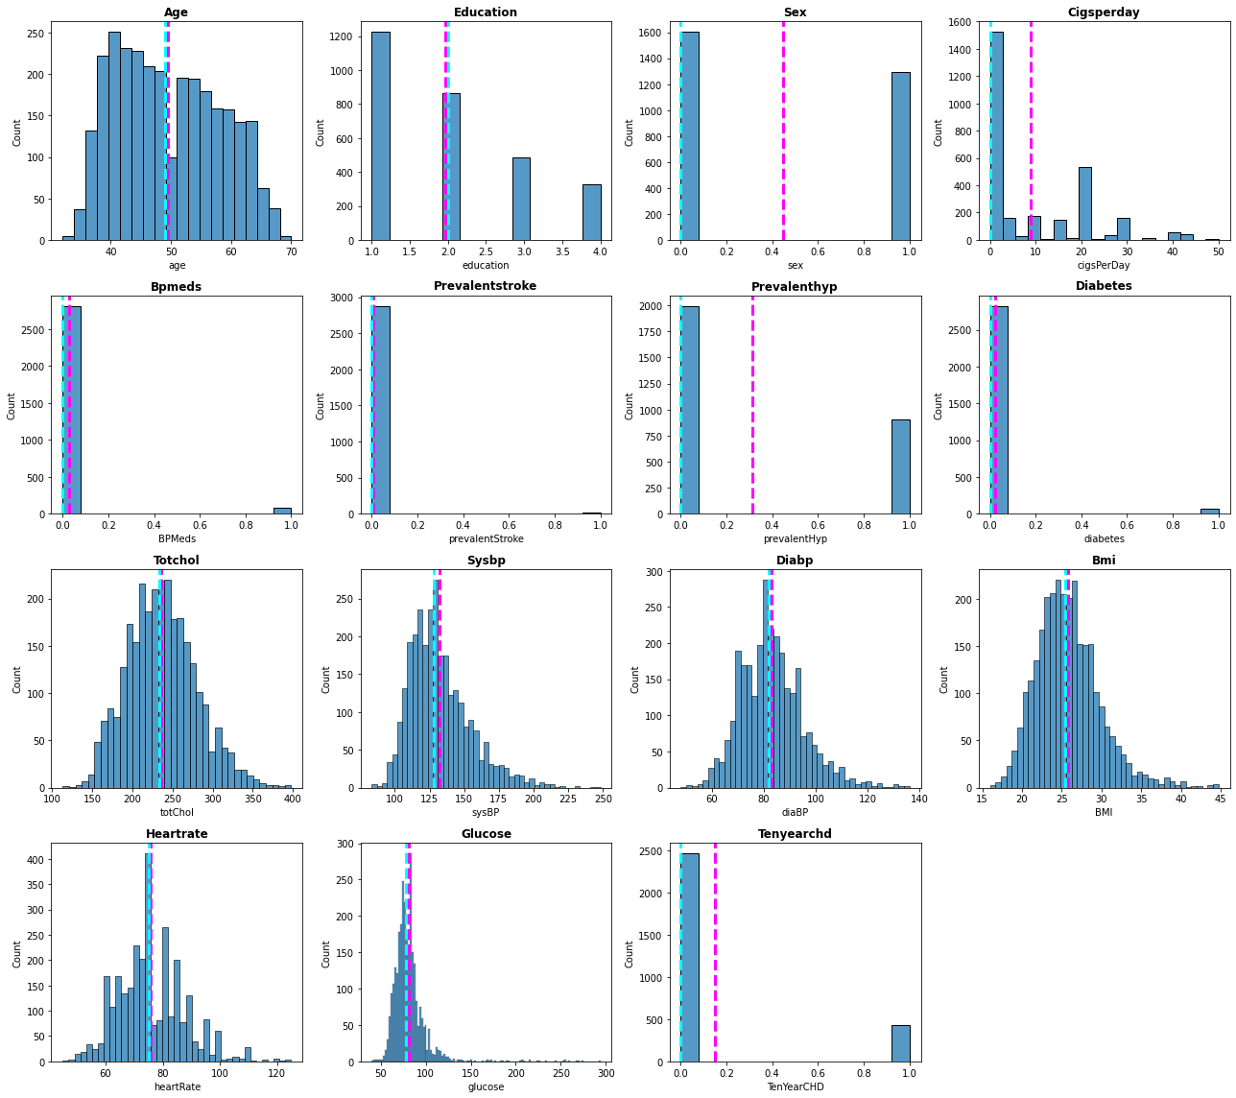
Univariate Analysis
11.From above histograms we can see how mean and median are positioned in distributions.

Slide 20
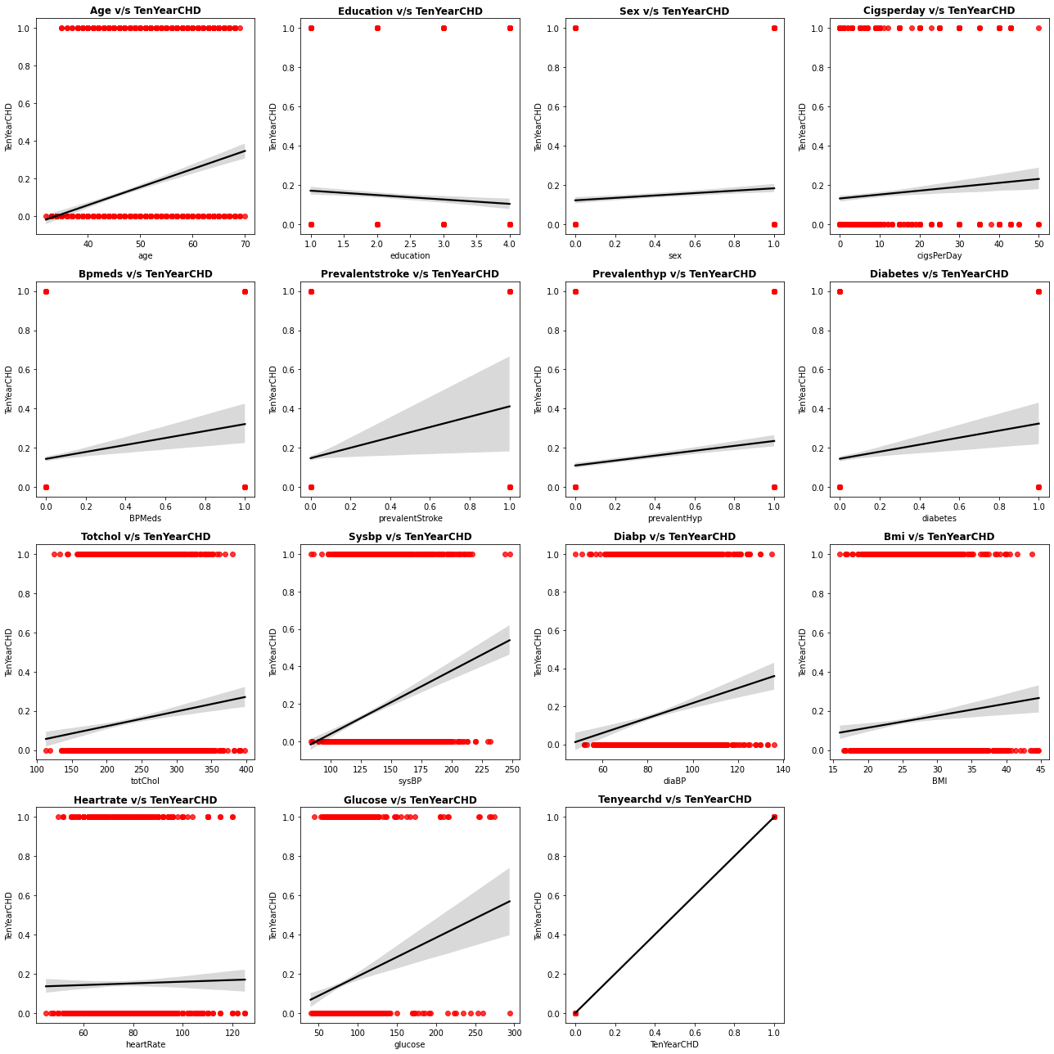
Bivariate Analysis
12.As we can see a lot of of Independent variables show relation with our Target variable.

Slide 21
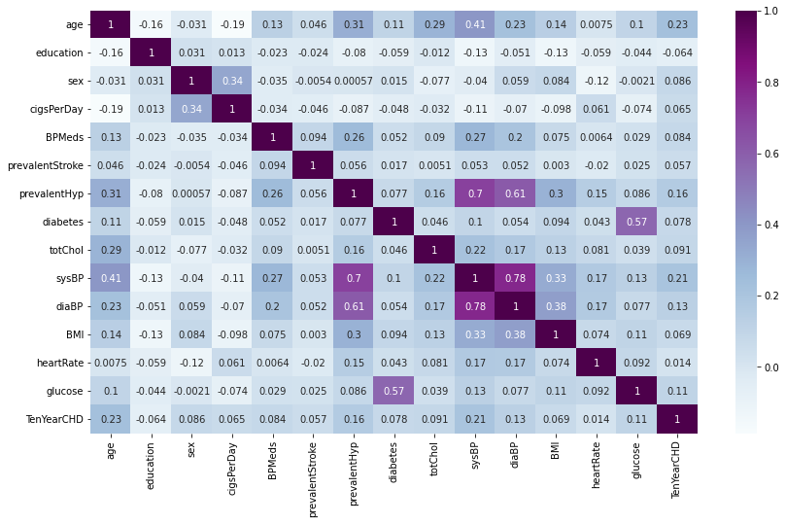
Multicollinearity
13.From the above Heatmap, We can see both of these columns(DiaBP and SysBP) are heavily correleted, there's some relationship we can establish with these two features further.

Slide 22
Model Development
Now that the Dataset is cleaned and we have added all the necessary features along with some conversions of categorical features. Its time to split the data into training and testing sets and observe how the models are performing.
These training and testing data are going to be same for all the model we'll build such that all the models are evaluated on a same set of parameters.

Slide 23
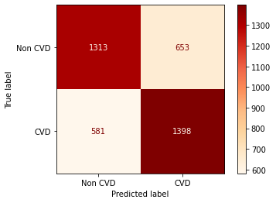

Logistic Regression
a)Visualizing the confusion matrix to evaluate the performance of the model on training set and testing set respectively.

Slide 24
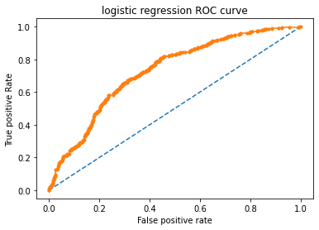
Precision | Recall | F1-Score | Accuracy | ROC_AUC
0.6627 | 0.6899 | 0.6761 | 0.6738 | 0.7285

Slide 25
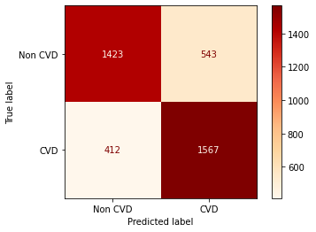
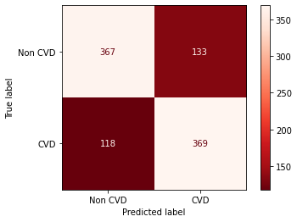
Decision Tree
a)Visualizing the confusion matrix to evaluate the performance of the model on training set and testing set respectively.

Slide 26
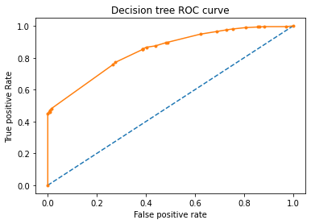
Precision | Recall | F1-Score | Accuracy | ROC_AUC
0.7351 | 0.7577 | 0.7462 | 0.7457 | 0.8442

Slide 27
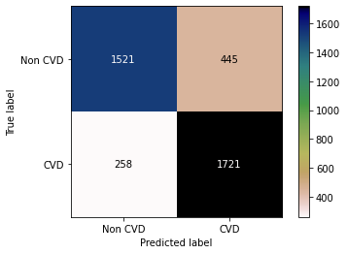
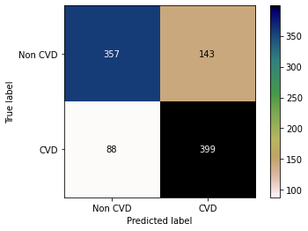
Random Forest Classifier
a)Visualizing the confusion matrix to evaluate the performance of the model on training set and testing set respectively.

Slide 28
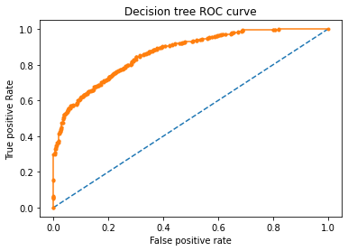
Precision | Recall | F1-Score | Accuracy | ROC_AUC
0.7362 | 0.8193 | 0.7755 | 0.766 | 0.8658

Slide 29
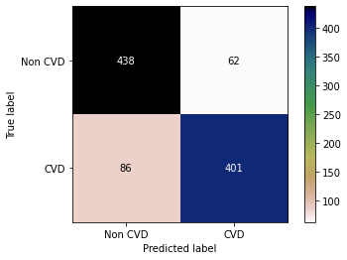
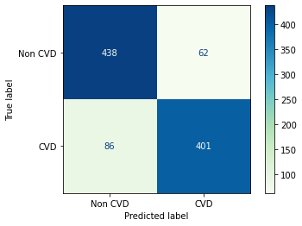
XGB Classifier
a) Visualizing the confusion matrix to evaluate the performance of the model on training set and testing set respectively.

Slide 30
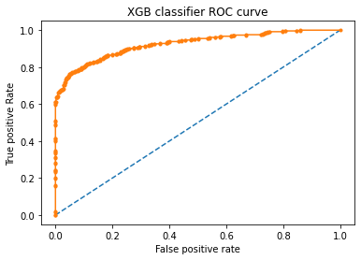
Precision | Recall | F1-Score | Accuracy | ROC_AUC
0.8661 | 0.8234 | 0.8442 | 0.8501 | 0.925

Slide 31
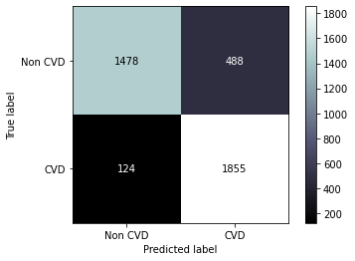
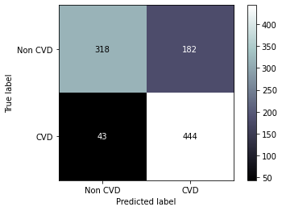
KNN
a)Visualizing the confusion matrix to evaluate the performance of the model on training set and testing set respectively.

Slide 32
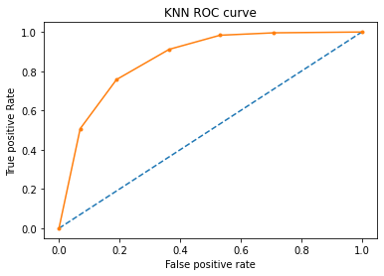
Precision | Recall | F1-Score | Accuracy | ROC_AUC
0.7093 | 0.9117 | 0.7978 | 0.772 | 0.8637

Slide 33
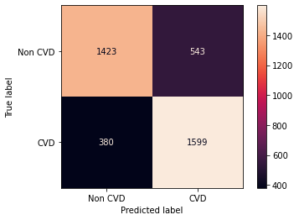
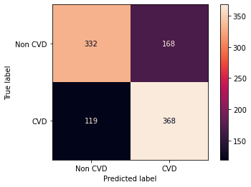
Support Vector Machine
Visualizing the confusion matrix to evaluate the performance of the model on
training set and testing set respectively.

Slide 34
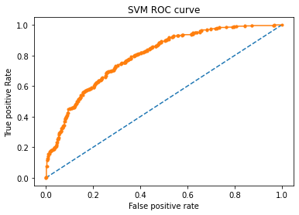
Precision | Recall | F1-Score | Accuracy | ROC_AUC
0.7465 | 0.808 | 0.776 | 0.766 | 0.8511

Slide 35
Conclusion
We've noticed that XBG Classifier is the stand out performer among all models with an f1-score of 0.8397. it's safe to say that XGB Classifier provides an optimal solution to our problem.
In case of Logistic regression, We were able to see the maximum f1-score of 0.658.
Out of the tree-based algorithms, the Random Forest Classifier was providing an optimal solution towards achieving our Objective. We were able to achieve an f1-score of 0.7703 We also noticed that in the case of Decision-tree Classifier, we were able to achieve an f1-score of 0.7034 for the test split.
For SVM(Support Vector Machines) Classifier, the f1-score lies around 0.7417.
Finally , As in the medical domain ( False negative values have importance we don't want to mis predict a person safe when he has the risk) recall ha the most importance. KNN, XGB , Random Forest gave the best recall 0.86 ,0.80 ,0.81.

Slide 36
References
https://towardsdatascience.com/
https://www.analyticsvidhya.com/
https://www.geeksforgeeks.org/python-data-visualization-tutorial

